Slide 1
Project Management CPM An Illustrative Example
Sidra Khalid

Slide 2
The House Construction Problem
The Build-Rite Construction Company has identified ten activities that take place in building a house. They are
Activity |  | Immediate Predecessors | Expected Time (days)
1 | Walls and Ceiling | 2 | 5
2 | Foundation | - | 3
3 | Roof Timbers | 1 | 2
4 | Roof Sheathing | 3 | 3
5 | Electrical Wiring | 1 | 4
6 | Roof Shingles | 4 | 8
7 | Exterior Siding | 8 | 5
8 | Windows | 1 | 2
9 | Paint | 6, 7, 10 | 2
10 | Inside Wall Board | 8, 5 | 3
Modified from Moore and Weatherford, Decision Modelling, Pearson 2001.

Slide 3
Critical Path Method (CPM)
Step 1: Forward pass
Step 2: Backward pass
Step 3: Calculating
Identify the critical path(s).
interpret the meaning of slacks and critical activities.

Slide 4
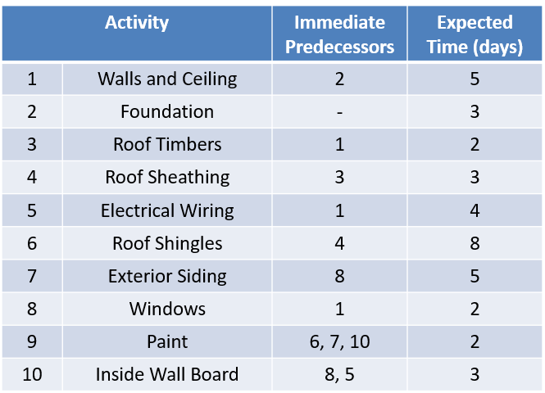
Notations
ES | EF
LS | LF
ES: Earliest Start LS: Latest Start TS: Total Slack
EF: Earliest Finish LF: Latest Finish FS: Free Slack
2
3
8
3
4
6
2
0
0
3
5
3
4
9
END
Start
2
1
10
5
2
5
8
7

Slide 5
Step 1: Forward Pass
9 | 10
11 | 13
14 | 21
2
3
8
3
4
6
22 | 23
1 | 3
4 | 8
9 | 12
13 | 15
2
3
5
3
4
9
2
1
10
5
9 | 10
11 | 15
2
5
8
7
Notations
ES | EF
LS | LF
ES: Earliest Start LS: Latest Start TS: Total Slack
EF: Earliest Finish LF: Latest Finish FS: Free Slack

Slide 6
Step 2: Backward Pass
8 | 10
9 | 10
9 | 10
10 | 13
11 | 13
11 | 13
13 | 21
14 | 21
14 | 21
2
3
8
3
4
6
21 | 23
22 | 23
22 | 23
0 | 3
1 | 3
1 | 3
3 | 8
4 | 8
4 | 8
12 | 15
8 | 12
13 | 15
19 | 21
9 | 12
15 | 18
2
3
5
3
4
9
2
1
10
5
8 | 10
9 | 10
15 | 16
10 | 15
11 | 15
17 | 21
2
5
8
7
Notations
ES | EF
LS | LF
ES: Earliest Start LS: Latest Start TS: Total Slack
EF: Earliest Finish LF: Latest Finish FS: Free Slack

Slide 7
Step 3: Calculating Slacks
TS = 0
FS = 0
TS = 0
FS = 0
TS = 0
FS = 0
The slacks are equal to zero for all the critical activities.
8 | 10
9 | 10
9 | 10
10 | 13
11 | 13
11 | 13
13 | 21
14 | 21
14 | 21
2
3
8
TS = 0
FS = 0
TS = 0
FS = 0
TS = 0
FS = 0
3
4
6
21 | 23
22 | 23
22 | 23
0 | 3
1 | 3
1 | 3
3 | 8
4 | 8
4 | 8
12 | 15
TS = 6
FS = 6
8 | 12
13 | 15
19 | 21
9 | 12
15 | 18
2
3
5
3
4
TS = 6
FS = 0
9
2
1
10
5
8 | 10
TS = 6
FS = 0
TS = 6
FS = 6
9 | 10
15 | 16
10 | 15
11 | 15
17 | 21
2
5
8
7
Notations
ES | EF
LS | LF
ES: Earliest Start LS: Latest Start TS: Total Slack
EF: Earliest Finish LF: Latest Finish FS: Free Slack

